Slide 1
PROJECT REVIEW 2
TEAM 10
05.03.2024

Slide 2
AGENDA
Sprints 2,3,4
Sprint Goals
Product Backlog Items, other results
Main findings from the Sprint Retros
Software demo
Software quality
Spent and remaining effort per person per Sprint

Slide 3
SPRINT 2
Date: November 29th, 2023 - January 21st, 2024
Long Sprint because of Christmas holidays
Sprint Goals:
Get Interaction between UI and current functionality.
Get started with ML.

Slide 4
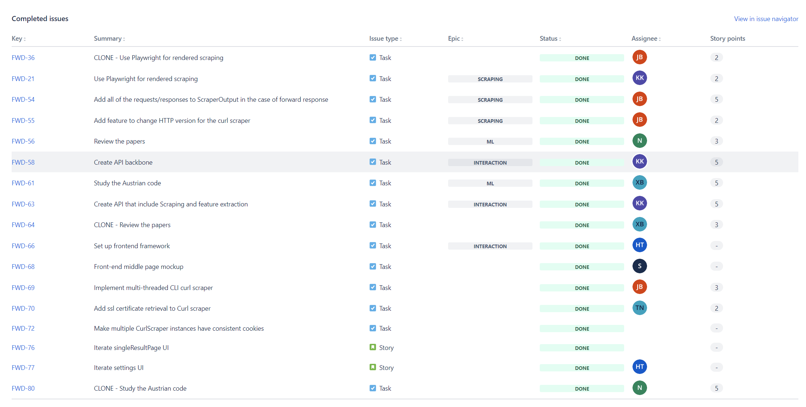
SPRINT 2
Items (Done)

Slide 5
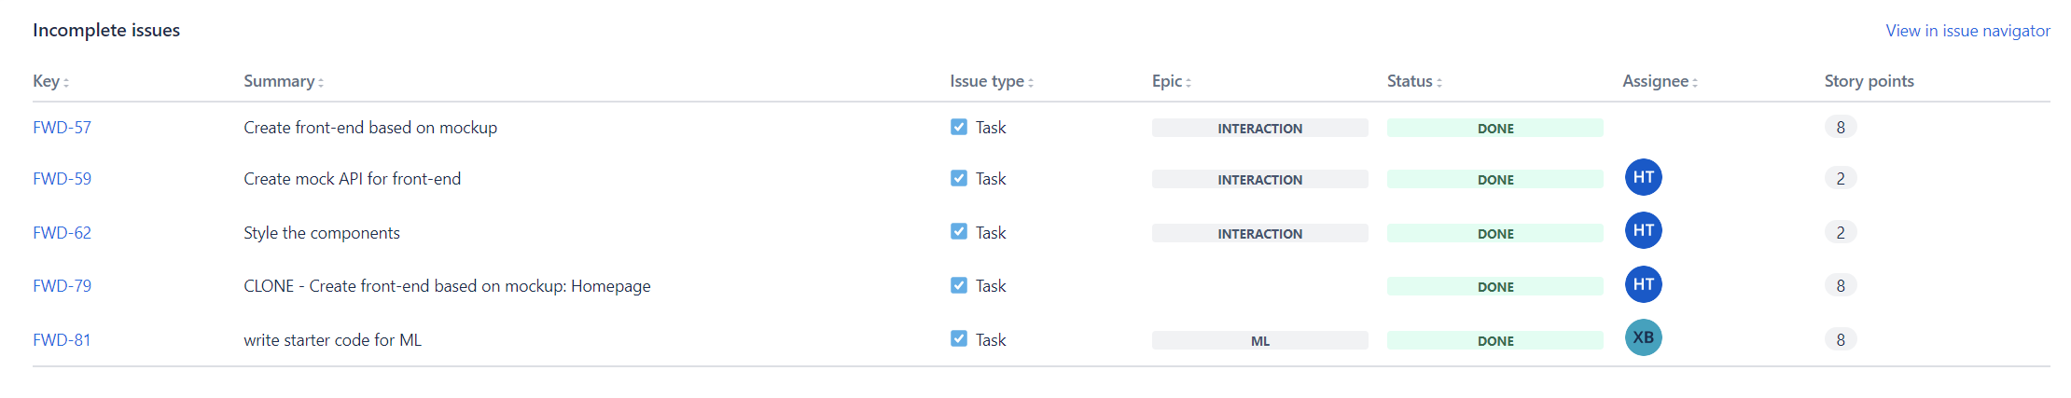
SPRINT 2
Items (Not done)

Slide 6
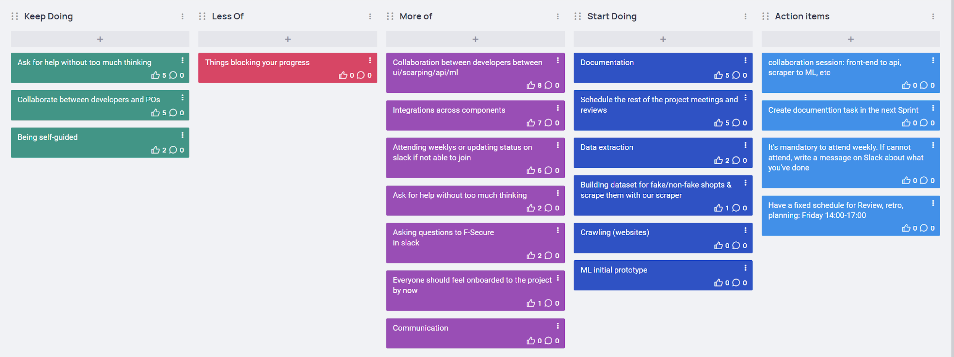
SPRINT 2
Retrospective

Slide 7
SPRINT 2
Other achievements:
Update the Definition of Done.
Update Quality attributes.
Agree to change to 2-week Sprint.

Slide 8
SPRINT 3
Date: January 22nd, 2024 - February 4th, 2024
Begin to change to 2-week Sprint
Sprint Goals:
The project is in a demoable state (whatever current functionality is) and can be tested by TPE (threat protection engineering) team.
Repo is ready to be shared and get feedback from F-Secure. (UI, API, interaction, scraping)
Processing of scraped data (fake/non-fake shops) to be used to train the model. (ML)

Slide 9
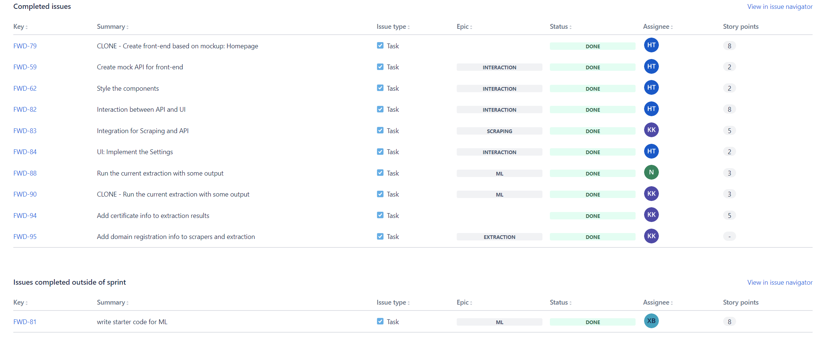
SPRINT 3
Items (Done)

Slide 10
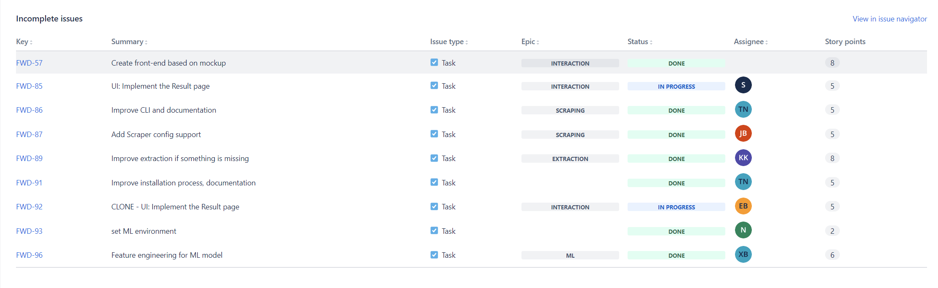
SPRINT 3
Items (Not done)

Slide 11
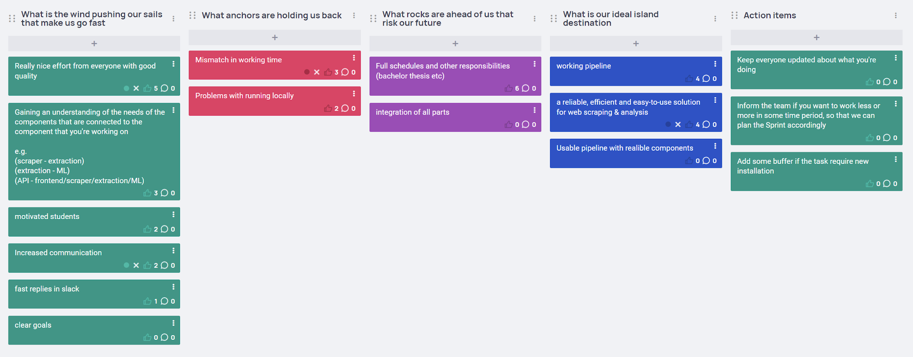
SPRINT 3
Retrospective

Slide 12
SPRINT 3
Other achievements:
Record the demo during Sprint Review for feedback from F-Secure.

Slide 13
SPRINT 4
Date: February 5th, 2024 - February 18th, 2024
Sprint Goals:
UI: Improvements on the UI (based on feedback of the Demo)
Scraping/Crawling: Optimizing performance of the scraper. Technical comparison of scraping components & suggestions for utilizing the computational/network resources without degrading performance
Extraction: Major focus on feature extraction - what currently exists; what could be added based on thesis
Towards ML: feature summaries, distributions, statistics and graphs etc as based on work in thesis.
General: Improvements in documentation

Slide 14
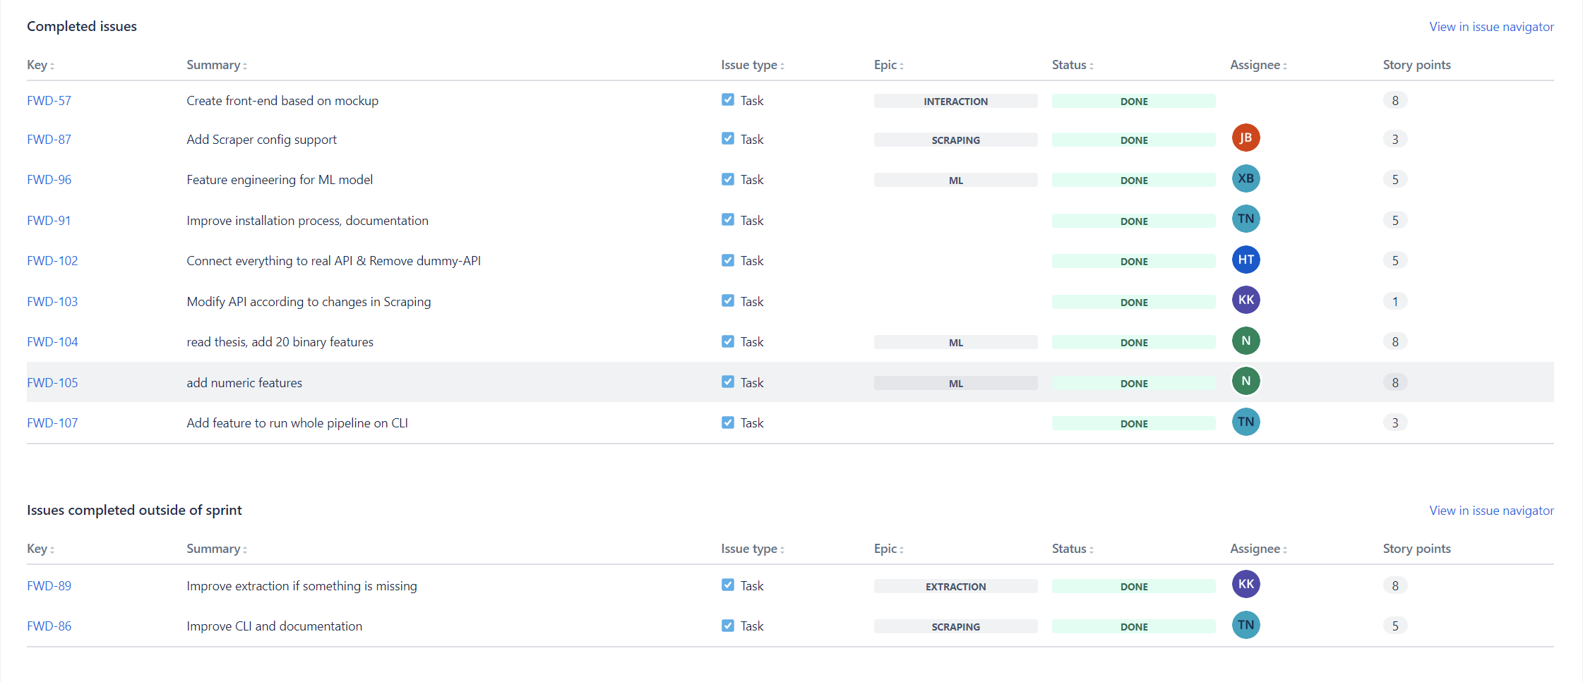
SPRINT 4
Items (Done)

Slide 15
SPRINT 4
Items (Not done)

Slide 16
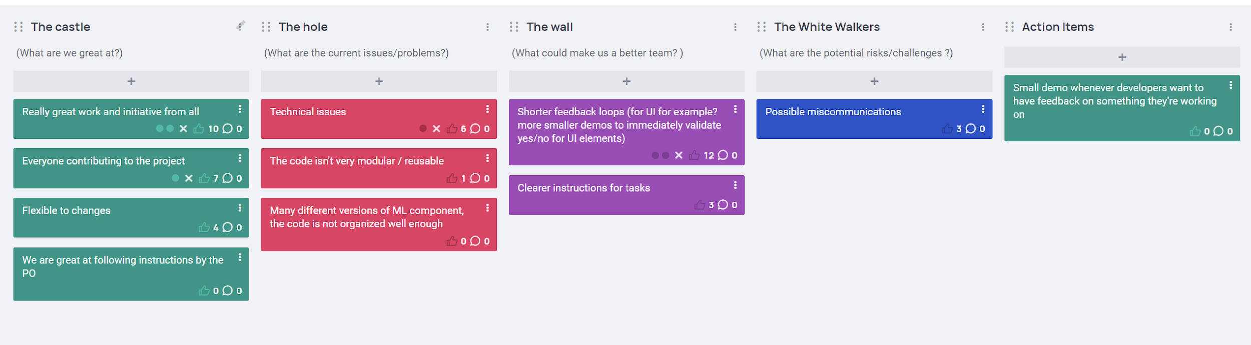
SPRINT 4
Retrospective

Slide 17
SPRINT 5
Currently, we are in the middle of Sprint 5

Slide 18
Architecture diagram
(shown separately)

Slide 19
SOFTWARE DEMO
UI
Scraping
API
ML

Slide 20
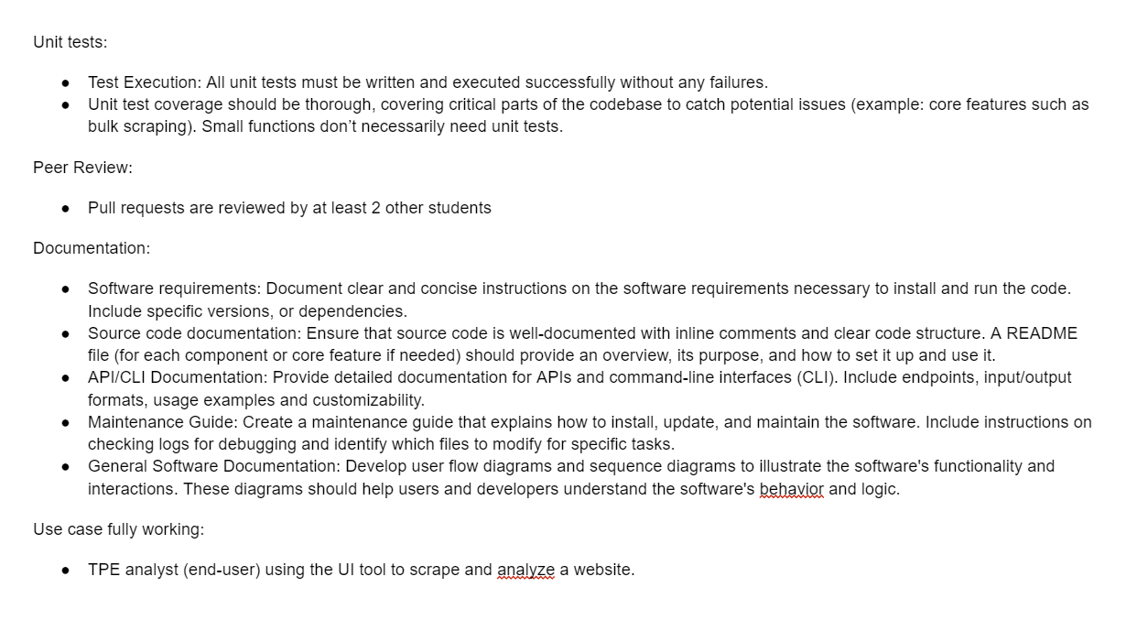
SOFTWARE QUALITY
Definition of Done

Slide 21
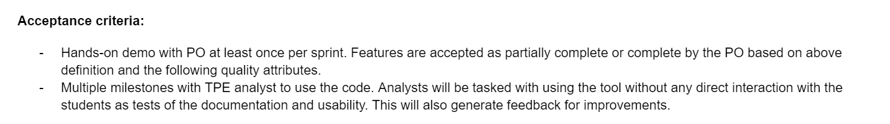
SOFTWARE QUALITY
Definition of Done

Slide 22
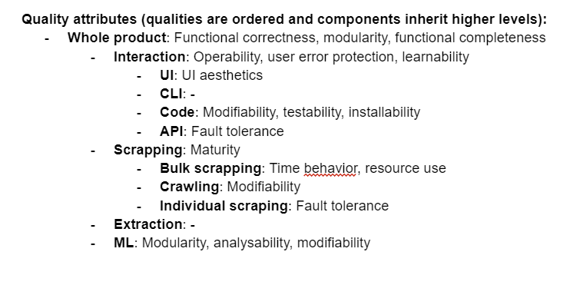
SOFTWARE QUALITY
Quality attributes

Slide 23
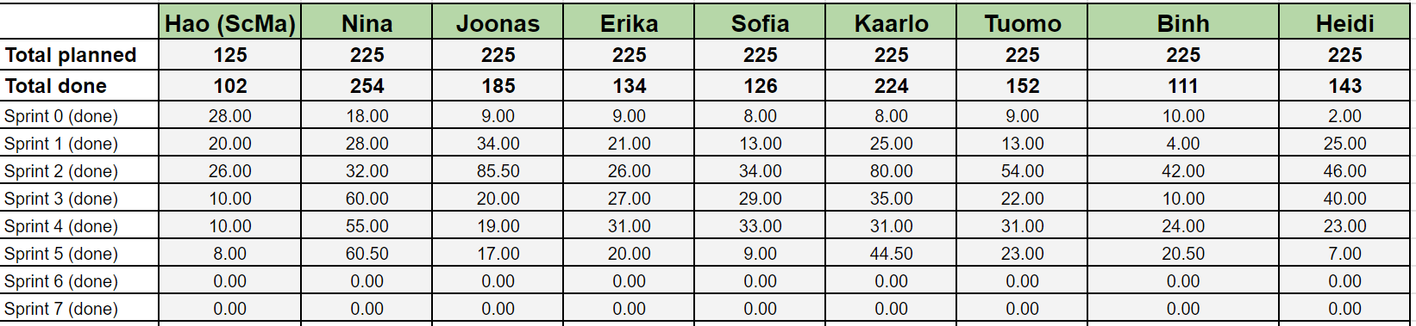
HOURS PLANNED AND DONE
(Screenshot captured on 05/03/2024)

